Slide 1
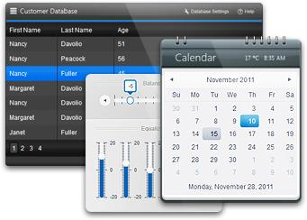


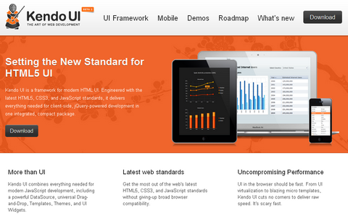
Kendo UI Mobile
Telerik JavaScript Framework
Hybrid Mobile Applications
Telerik Software Academy
http://academy.telerik.com

Slide 2

Table of Contents
DataSource
Templates
UI Mobile Widgets
Model - View - View Model (MVVM)
Icenium and Kendo Mobile

Slide 3

DataSource
Data, data, data

Slide 4

DataSource
Abstraction over local or remote data
Play central role in Kendo UI applications
Retrieve data from local or remote end point
Provides CRUD operations and serialization
Provides filtering, grouping, page sizing
Synchronizing updates (batch and normal)
And many more

Slide 5

DataSource
Initialization with new kendo.data.DataSource
Takes an JSON object as parameter
The JSON object contains variable options
data option – array of same objects or string
var cars = [
{ make: 'Opel', model: 'Insignia' , year: '2009'},
{ make: 'Audi', model: 'A5', year: '2008'},
{ make: 'BMW', model: 'M3', year: '2010'},
{ make: 'Mercedes', model: 'CL', year: '2011'}
];
var carsDataSource = new kendo.data.DataSource({
data: cars
});

Slide 6

DataSource
columns option – array of objects
field, width, title
aggregate option – array of objects
field, aggregate
"average", "count", "max", "min", "sum"
…
columns: [
{ field: 'make', width: 50, title: 'Make' },
{ field: 'model', width: 50, title: 'Model' }
],
aggregate: [
{ field: 'power', aggregate: 'sum' },]
…

Slide 7

DataSource
filter option – array of objects
logic option: ‘and’, ‘or’
filters option: array of objects
field, operator, value
operators: "eq", "neq", "lt", "lte", "gt", "gte"
…
filter: {
logic: 'and',
filters: [
{ field: 'make', operator: 'eq', value: 'Audi' },
{ field: 'year', operator: 'gt', value: 2006 }
]
}
…

Slide 8

DataSource
group option – array of objects
field, dir, aggregates
dir: ‘asc’ and ‘desc’
…
group: {
field: 'make',
dir: 'desc',
aggregates: [
{ field: 'power', aggregate: 'max' },
{ field: 'make', aggregate: 'count' }
]
}
…

Slide 9

DataSource
sort option – array of objects
field, dir
dir: ‘asc’ and ‘desc’
…
sort: {[
{ field: 'year', dir: 'desc' },
{ field: 'make', dir: 'asc' }
]}
…

Slide 10

DataSource
transport option – array of objects
create, read, update, destroy
url, dataType
parameterMap – function for parsing data
…
transport: {
read: {
url: 'http://someurl.com/api/read',
dataType: 'json'
},
…

Slide 11

DataSource
batch option – boolean
page option – number
pageSize option – number
serverPaging option – boolean
serverSorting option - boolean
events – change, error, sync
…
change: function (e) {
…
}
…

Slide 12
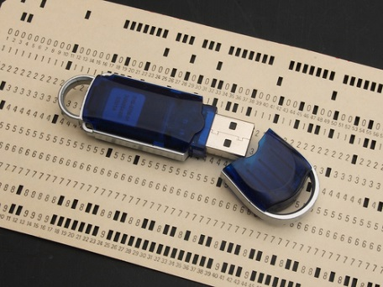
DataSource
Methods
add – object or Kendo.data.model
aggregate – get or set configuration
aggregates – returns result
at – indexator
data – gets or sets the data array
fetch – reads the data, needs ready function
filter – gets or sets the configuration
group – gets or sets the configuration
indexOf – return the index of an object in data

Slide 13
DataSource
Methods
insert – inserts data at specified index
page – gets or sets the current page
pageSize – gets or sets the page size
read – reads the data
remove – removes item
sort – gets or sets the configuration
sync – syncs data with remote service
total – number of items in data
view – return corresponding data (with fetch)

Slide 14
DataSource
Live Demo on try.kendoui.com

Slide 15

Templates
Mustache, Beard, Eyebrows

Slide 16
Templates
Kendo UI templates – in script tags
Type of tag – “text/x-kendo-template”
Should have id attribute
Initialized with kendo.template($('#id').html())
Takes object parameter with data
Appended to other DOM (jQuery) elements
<script type="text/x-kendo-template" id="some-id">
// template </script>
var tmpl = kendo.template($('#some-id').html());
$('#some-tag').append(template({ /* data obj */ }));

Slide 17

Templates
Syntax
Normal HTML syntax
# Between number sign you can write JS code
#: Takes a string from a parameter
#= Takes the value from a parameter
<script type="text/x-kendo-template" id="car">
<div>
<span>#: make #, </span>
<a href="/cars/#= id #">#: model #</a>
</div>
</script>
var carTemplate = kendo.template($('#car').html());
$('#some-tag').append(template({
id: i, make: car.make, model: car.model }));

Slide 18
Templates
Live Demo on try.kendoui.com

Slide 19
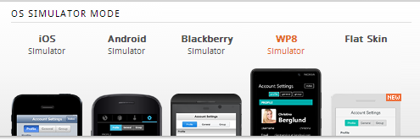
Kendo Mobile Widgets
Native feel on various devices

Slide 20
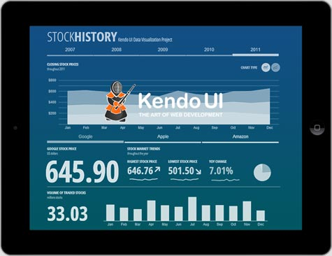
DataSource
Widgets
ActionSheet
Button
ButtonGroup
ListView
ModalView
NavBar
PopOver
Scroller
ScrollView
TabStrip

Slide 21
Kendo Mobile Widgets
Live Demo on demos.kendoui.com

Slide 22
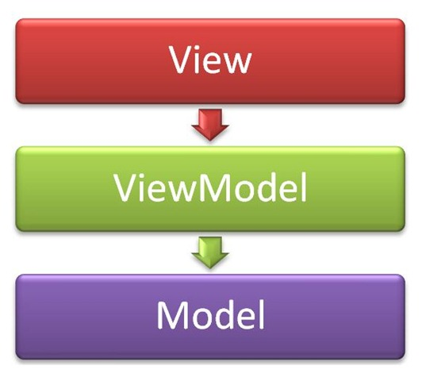
MVVM in KendoUI
Model – View – View Model

Slide 23
MVVM in Kendo UI
Model
Represents data (database, objects, etc.)
View Model
Knows of the data
Transforms the data as the View needs it
May have logic and functionality
View
Knows of the View Model
Represents UI (buttons, inputs, etc.)

Slide 24
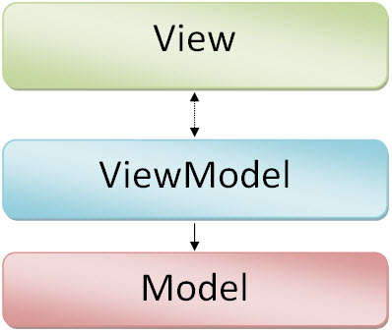
MVVM in Kendo UI
Model – kendo.data.DataSource
View Model – kendo.observable(object)
Object – has properties for the View
May have functions for manipulating data
Layout - kendo.Layout(string)
String to render (HTML text)
Displays views

Slide 25

MVVM in Kendo UI
View - kendo.View
string (template id)
string (template id) and View Model
var layout = new kendo.Layout(
'<div id="no-model">' + '</div>' +
'<div id="model">' + '</div>');
var first = new kendo.View(‘tmpl');
var second = new kendo.View(‘tmpl-model',
{ model: carViewModel });
layout.render($('#main-layout'));
layout.showIn('#no-model', carListView);
layout.showIn('#model', carDetailView);

Slide 26
MVVM in Kendo UI
Data Binding
Add attribute “data-bind” to tags in template
Value of attribute is “{type} : {property}”
<script type="text/kendo-tmpl" id="car-template">
<div>
<img data-bind="attr: { src: image }" />
<span data-bind="text: make"></span>
<input data-bind="value: power“ />
<input type="checkbox" data-bind="checked: agreed" />
<div data-bind="visible: added">
</div>
</script>

Slide 27

MVVM in Kendo UI
Events Data Binding
Add attribute “data-bind” to tags in template
Value of attribute is “events: {object of events}”
<button data-bind="events: { click: onClick }">B</button>
var viewModel = kendo.observable({
onClick : function(e) {
console.log("Event: " + e.type);
}
});

Slide 28
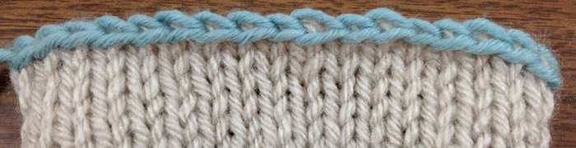
MVVM in Kendo UI
Bind View Model To View
Done through kendo.bind(template, viewModel)
Template is jQuery object
View Model is kendo.observable
kendo.bind($("#example"), viewModel);

Slide 29
MVVM in Kendo UI Mobile
Model is automatically bound
Done through the bind method
You need to set only data attributes
<script>
var cat = {
color: "purple", legs: 4
}
</script>
<div data-role="view" data-model="cat">
<span data-bind="text:color"></span>
<span data-bind="text:legs"></span>
</div>

Slide 30
Views And Layouts
Live Demo on try.kendoui.com

Slide 31
Icenium and Kendo Mobile
It is only JavaScript!

Slide 32
Kendo UI Web
http://academy.telerik.com

Slide 33
Homework
Create a cross-platform hybrid mobile application using Kendo UI and Icenium for car rental service. Use SQLLite or Local file for data saving and retrieval. Use at least three Kendo UI Mobile widgets.
Available cars for rent
Car details and rent option
Rented cars with return date
Home/About/Contacts view

